Slide 1
CHAPTER 1
BASIC CONCEPT
All the programs in this file are selected from
Ellis Horowitz, Sartaj Sahni, and Susan Anderson-Freed
“Fundamentals of Data Structures in C”,
Computer Science Press, 1992.

Slide 2
How to create programs
Requirements
Analysis: bottom-up vs. top-down
Design: data objects and operations
Refinement and Coding
Verification
  Program Proving
  Testing
  Debugging

Slide 3
Algorithm
Definition
An algorithm is a finite set of instructions that accomplishes a particular task.
Criteria
  input
  output
  definiteness: clear and unambiguous
  finiteness: terminate after a finite number of steps
  effectiveness: instruction is basic enough to be carried out

Slide 4
Data Type
Data Type
A data type is a collection of objects and a set of operations that act on those objects.
Abstract Data Type
An abstract data type(ADT) is a data type that is organized in such a way that the specification of the objects and the operations on the objects is separated from the representation of the objects and the implementation of the operations.

Slide 5
Specification vs. Implementation
Operation specification
  function name
  the types of arguments
  the type of the results
Implementation independent

Slide 6
*Structure 1.1:Abstract data type Natural_Number (p.17) structure Natural_Number is objects: an ordered subrange of the integers starting at zero and ending at the maximum integer (INT_MAX) on the computer functions: for all x, y ∈ Nat_Number; TRUE, FALSE ∈ Boolean and where +, -, <, and == are the usual integer operations.
Nat_No Zero ( ) ::= 0
Boolean Is_Zero(x) ::= if (x) return FALSE else return TRUE
Nat_No Add(x, y) ::= if ((x+y) <= INT_MAX) return x+y else return INT_MAX
Boolean Equal(x,y) ::= if (x== y) return TRUE else return FALSE
Nat_No Successor(x) ::= if (x == INT_MAX) return x else return x+1
Nat_No Subtract(x,y) ::= if (x<y) return 0 else return x-y end Natural_Number
::= is defined as

Slide 7
Measurements
Criteria
  Is it correct?
  Is it readable?
  …
Performance Analysis (machine independent)
  space complexity: storage requirement
  time complexity: computing time
Performance Measurement (machine dependent)

Slide 8
Space Complexity
S(P)=C+S_{P}(I)
Fixed Space Requirements (C)
Independent of the characteristics of the inputs and outputs
  instruction space
  space for simple variables, fixed-size structured variable, constants
Variable Space Requirements (S_{P}(I))
depend on the instance characteristic I
  number, size, values of inputs and outputs associated with I
  recursive stack space, formal parameters, local variables, return address

Slide 9
*Program 1.9: Simple arithmetic function (p.19) float abc(float a, float b, float c)
{ return a + b + b * c + (a + b - c) / (a + b) + 4.00;
}
*Program 1.10: Iterative function for summing a list of numbers (p.20) float sum(float list[ ], int n)
{ float tempsum = 0; int i; for (i = 0; i<n; i++) tempsum += list [i]; return tempsum;
}
S_{abc}(I) = 0
S_{sum}(I) = 0
Recall: pass the address of the
first element of the array &
pass by value

Slide 10
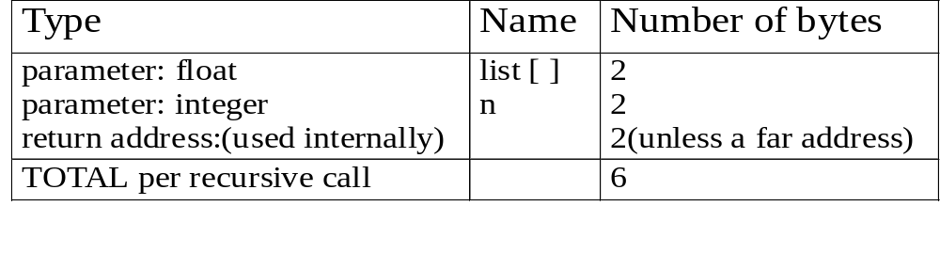
*Program 1.11: Recursive function for summing a list of numbers (p.20) float rsum(float list[ ], int n)
{ if (n) return rsum(list, n-1) + list[n-1]; return 0;
}
*Figure 1.1: Space needed for one recursive call of Program 1.11 (p.21)
S_{sum}(I)=S_{sum}(n)=6n
Assumptions:

Slide 11
Time Complexity
T(P)=C+T_{P}(I)
Compile time (C)
independent of instance characteristics
run (execution) time T_{P}
Definition
A program step is a syntactically or semantically meaningful program segment whose execution time is independent of the instance characteristics.
Example
  abc = a + b + b * c + (a + b - c) / (a + b) + 4.0
  abc = a + b + c
T_{P}(n)=c_{a}ADD(n)+c_{s}SUB(n)+c_{l}LDA(n)+c_{st}STA(n)
Regard as the same unit
machine independent

Slide 12
Methods to compute the step count
Introduce variable count into programs
Tabular method
  Determine the total number of steps contributed by each statement
  step per execution × frequency
  add up the contribution of all statements

Slide 13
*Program 1.12: Program 1.10 with count statements (p.23) float sum(float list[ ], int n)
{ float tempsum = 0; count++; /* for assignment */ int i; for (i = 0; i < n; i++) { count++; /*for the for loop */ tempsum += list[i]; count++; /* for assignment */
} count++; /* last execution of for */ return tempsum; count++; /* for return */
}
Iterative summing of a list of numbers
2n + 3 steps

Slide 14
*Program 1.13: Simplified version of Program 1.12 (p.23) float sum(float list[ ], int n)
{ float tempsum = 0; int i; for (i = 0; i < n; i++) count += 2; count += 3; return 0;
}
2n + 3 steps

Slide 15
*Program 1.14: Program 1.11 with count statements added (p.24) float rsum(float list[ ], int n)
{ count++; /*for if conditional */ if (n) { count++; /* for return and rsum invocation */ return rsum(list, n-1) + list[n-1];
} count++; return list[0];
}
Recursive summing of a list of numbers
2n+2

Slide 16
*Program 1.15: Matrix addition (p.25) void add( int a[ ] [MAX_SIZE], int b[ ] [MAX_SIZE], int c [ ] [MAX_SIZE], int rows, int cols)
{ int i, j; for (i = 0; i < rows; i++) for (j= 0; j < cols; j++) c[i][j] = a[i][j] +b[i][j];
}
Matrix addition

Slide 17
*Program 1.16: Matrix addition with count statements (p.25) void add(int a[ ][MAX_SIZE], int b[ ][MAX_SIZE], int c[ ][MAX_SIZE], int row, int cols )
{ int i, j; for (i = 0; i < rows; i++){ count++; /* for i for loop */ for (j = 0; j < cols; j++) { count++; /* for j for loop */ c[i][j] = a[i][j] + b[i][j]; count++; /* for assignment statement */
} count++; /* last time of j for loop */
} count++; /* last time of i for loop */
}
2rows * cols + 2 rows + 1

Slide 18
*Program 1.17: Simplification of Program 1.16 (p.26) void add(int a[ ][MAX_SIZE], int b [ ][MAX_SIZE], int c[ ][MAX_SIZE], int rows, int cols)
{ int i, j; for( i = 0; i < rows; i++) { for (j = 0; j < cols; j++) count += 2; count += 2;
} count++;
}
2rows × cols + 2rows +1
Suggestion: Interchange the loops when rows >> cols

Slide 19
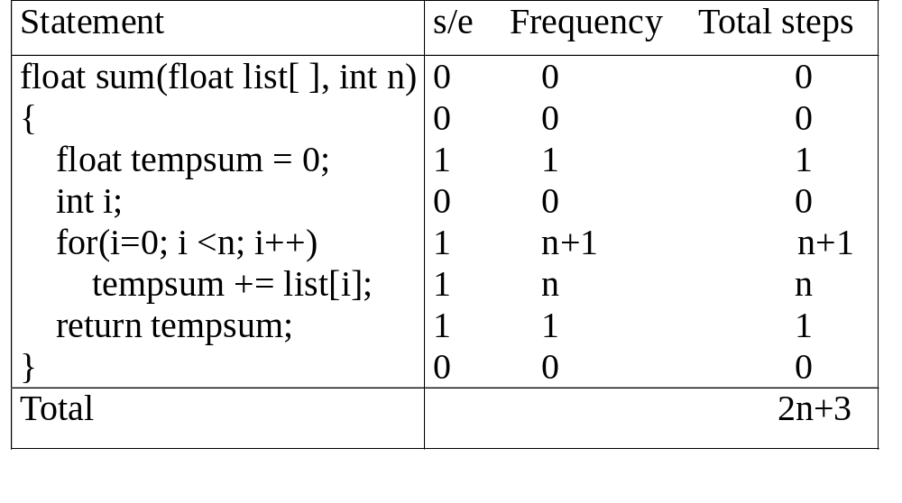
*Figure 1.2: Step count table for Program 1.10 (p.26)
Tabular Method
Iterative function to sum a list of numbers
steps/execution

Slide 20
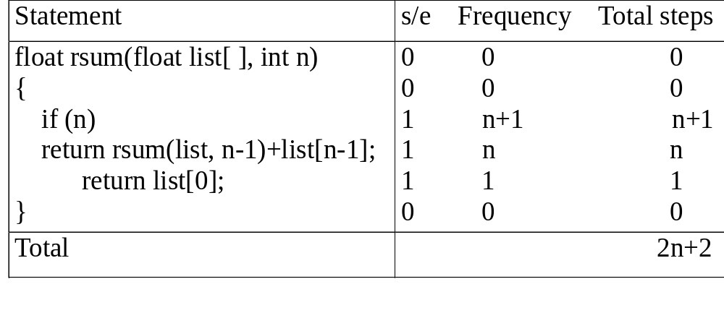
*Figure 1.3: Step count table for recursive summing function (p.27)
Recursive Function to sum of a list of numbers

Slide 21
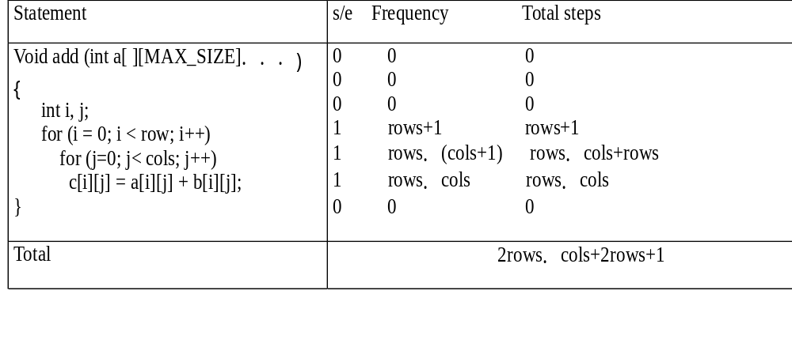
*Figure 1.4: Step count table for matrix addition (p.27)
Matrix Addition

Slide 22
*Program 1.18: Printing out a matrix (p.28) void print_matrix(int matrix[ ][MAX_SIZE], int rows, int cols)
{ int i, j; for (i = 0; i < row; i++) { for (j = 0; j < cols; j++) printf(“%d”, matrix[i][j]); printf( “\n”);
}
}
Exercise 1

Slide 23
*Program 1.19:Matrix multiplication function(p.28) void mult(int a[ ][MAX_SIZE], int b[ ][MAX_SIZE], int c[ ][MAX_SIZE])
{ int i, j, k; for (i = 0; i < MAX_SIZE; i++) for (j = 0; j< MAX_SIZE; j++) { c[i][j] = 0; for (k = 0; k < MAX_SIZE; k++) c[i][j] += a[i][k] * b[k][j];
}
}
Exercise 2

Slide 24
*Program 1.20:Matrix product function(p.29) void prod(int a[ ][MAX_SIZE], int b[ ][MAX_SIZE], int c[ ][MAX_SIZE], int rowsa, int colsb, int colsa)
{ int i, j, k; for (i = 0; i < rowsa; i++) for (j = 0; j< colsb; j++) { c[i][j] = 0; for (k = 0; k< colsa; k++) c[i][j] += a[i][k] * b[k][j];
}
}
Exercise 3

Slide 25
*Program 1.21:Matrix transposition function (p.29) void transpose(int a[ ][MAX_SIZE])
{ int i, j, temp; for (i = 0; i < MAX_SIZE-1; i++) for (j = i+1; j < MAX_SIZE; j++)
SWAP (a[i][j], a[j][i], temp);
}
Exercise 4

Slide 26
Asymptotic Notation (O)
Definition
f(n) = O(g(n)) iff there exist positive constants c and n₀ such that f(n) ≤ cg(n) for all n, n ≥ n₀.
Examples
  3n+2=O(n) /* 3n+2≤4n for n≥2 */
  3n+3=O(n) /* 3n+3≤4n for n≥3 */
  100n+6=O(n) /* 100n+6≤101n for n≥10 */
  10n²+4n+2=O(n²) /* 10n²+4n+2≤11n² for n≥5 */
  6*2^{n}+n²=O(2^{n}) /* 6*2^{n}+n² ≤7*2^{n} for n≥4 */

Slide 27
Example
Complexity of c₁n²+c₂n and c₃n
  for sufficiently large of value, c₃n is faster than c₁n²+c₂n
  for small values of n, either could be faster
    c₁=1, c₂=2, c₃=100 --> c₁n²+c₂n ≤ c₃n for n ≤ 98
    c₁=1, c₂=2, c₃=1000 --> c₁n²+c₂n ≤ c₃n for n ≤ 998
  break even point
    no matter what the values of c1, c2, and c3, the n beyond which c₃n is always faster than c₁n²+c₂n

Slide 28
O(1): constant
O(n): linear
O(n²): quadratic
O(n³): cubic
O(2^{n}): exponential
O(logn)
O(nlogn)

Slide 29
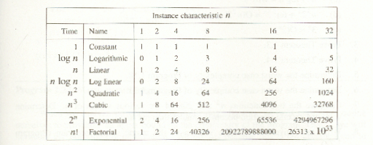
*Figure 1.7:Function values (p.38)

Slide 30
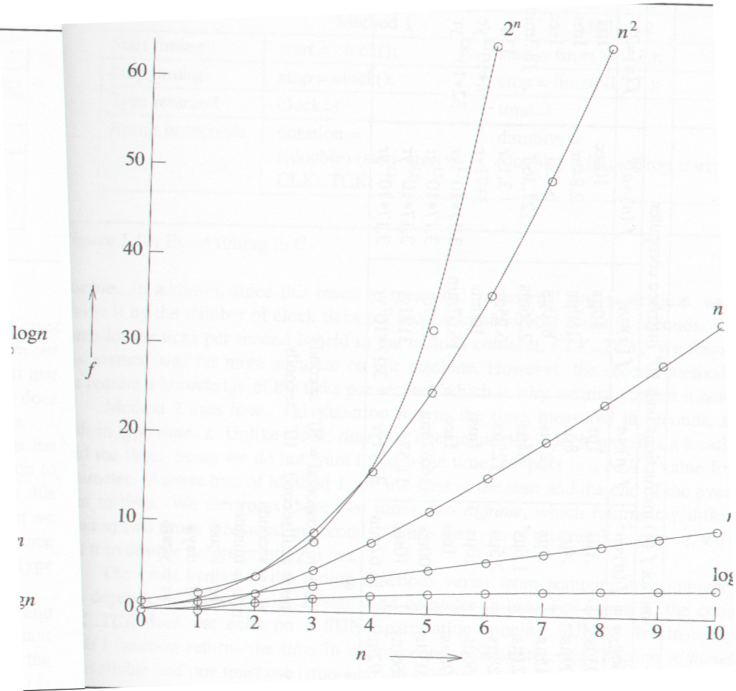
*Figure 1.8:Plot of function values(p.39)
nlogn
n
logn

Slide 31
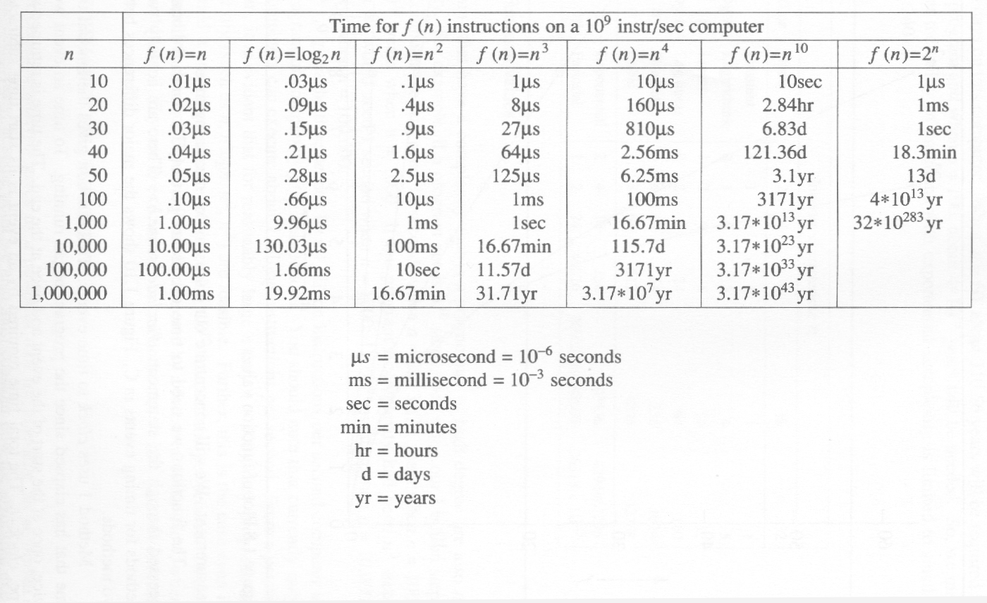
*Figure 1.9:Times on a 1 billion instruction per second computer(p.40)

